Slide 1
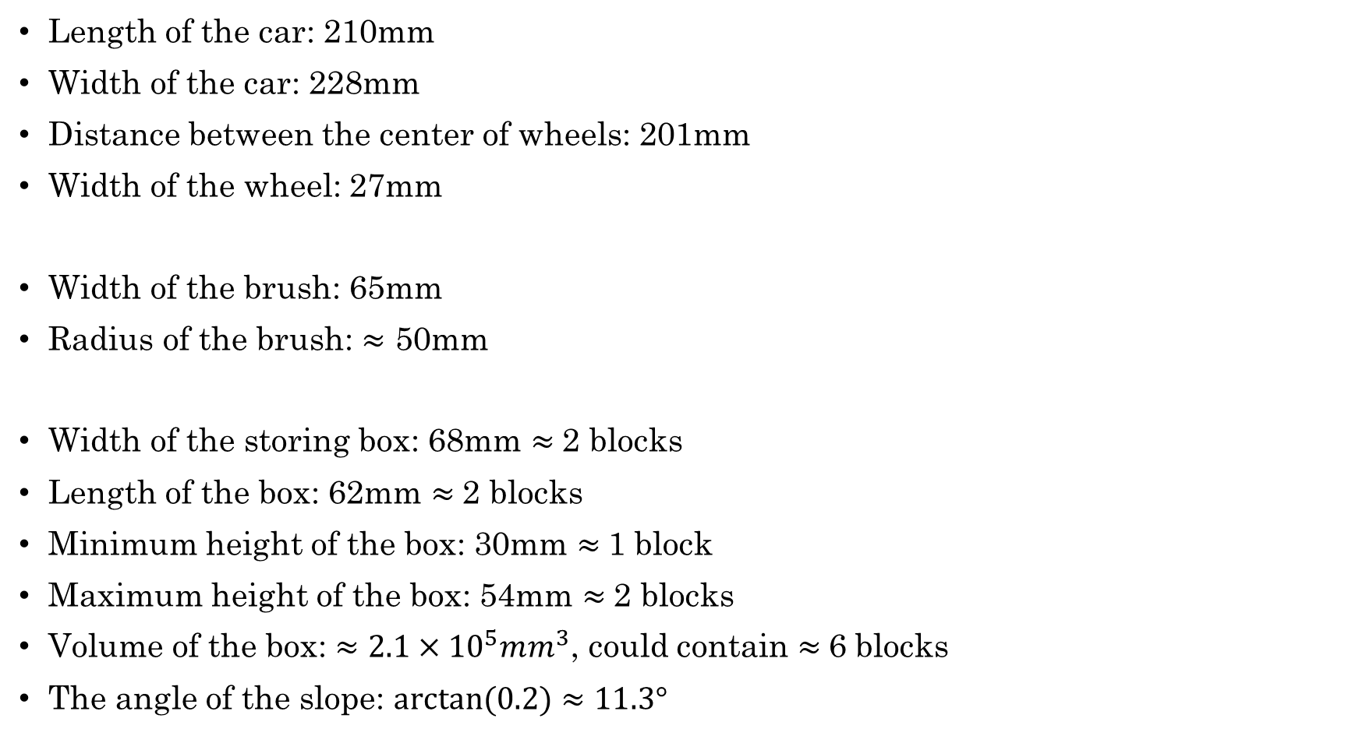
Parameters of the Car
Length of the car: 210mm
Width of the car: 228mm
Distance between the center of wheels: 201mm
Width of the wheel: 27mm
Width of the brush: 65mm
Radius of the brush: $≈$ 50mm
Width of the storing box: 68mm $≈$2 blocks
Length of the box: 62mm $≈$2 blocks
Minimum height of the box: 30mm $≈$1 block
Maximum height of the box: 54mm $≈$2 blocks
Volume of the box: $≈2.1×{10}^{5}mm^{3}$, could contain $≈$6 blocks
The angle of the slope: $arctan⁡(0.2)≈11.3°$

